Slide 1



MICROFINANCE
GLOBAL
CASE COMPETITION 2023
Team PPNK
Krish Gupta Nikhil Jain Prakhar Singh
Pratiksha Satapathy

Slide 2
Overview
A glimpse into the offerings and operations of UFH paired with the proposed solutions

Slide 3

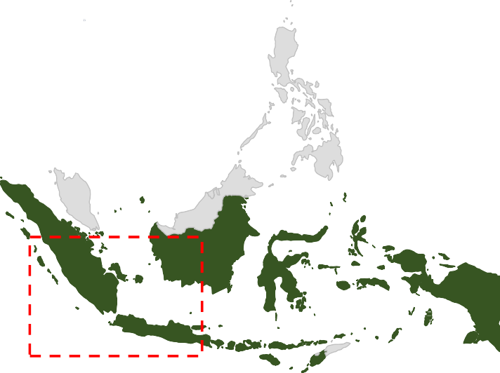












Bird's Eye View: United for Hope Microfinance
An insight into United for Hope Microfinance
Indonesian microfinance institution established in 2003 in the Javan region
Company Goals
250
200
150
100
50
0
-50
-100
-150
-200
-250
Originally established as a private company with 8 shareholders but has expanded since then
Maximize Client Value
FY 19
FY 20
FY 21
FY 22
FY 23
Is committed to providing financial services to marginalized low-income households
Employee Goal Fulfilment
Equal Opportunity Employer
Reducing Profitability
Amount
(in 000)
Rate
Client Type
Individual Loans
Small business or family, first time client
22.5%
Causes for falling profits
1
Communication Issues
2
3
Aftermath of
Pandemic
Legacy System
Rp 3500
Loan
Offerings
Small Enterprise
Rp 7000
Established small business or family, existing client
Difficulty in coordinating operations between the Sumatran and Javan branches
Physical filing of loans, cash collection, credit scoring etc. results in 10 day loan application time
The pandemic affected the economically vulnerable disproportionately, the target demographic of MFIs
22.5%
Established Client
Rp 7000-15000
Loyal, reliable client,
terms negotiable
15%-
22.5%
OVERVIEW FINTECH
CREDIT RATINGS
ALTERNATE LENDING
SUBAKS
TIMELINE
RISK MITIGATIONS
FINANCIALS

Slide 4












Dual Obstacle Perspective
Issues experienced by the two parties in Microfinance loan transactions
CUSTOMER’S SIDE PROBLEM
COMPANY’S SIDE PROBLEM
UNCERTAINITY
Most of the farmers in Indonesia depend on seasonal rainfall and
LEGACY SYSTEMS
Old physical legacy systems in place which lead to high employee costs
01
01
CUMBERSOME
It usually takes 10 days for borrowers to get the loan
CREDIT DEFAULT
The number of people who’ve defaulted have increased to 8%
02
02
INTEREST RATE
They usually have to borrow at a
higher rate as compared to banks
RIGIDITY
Rigid loan structures in the company's loan offerings discourage borrowers.
03
03
INTELIGIBILITY TO APPLY
Many of the underprivileged don't even apply for loans since they know they won't be eligible in the status quo.
CREDIT SCORING
A limited outlook of solely the economic well-being makes the present credit scoring system unreliable
04
04
OVERVIEW
FINTECH
CREDIT RATINGS
ALTERNATE LENDING
SUBAKS
TIMELINE
RISK MITIGATIONS
FINANCIALS

Slide 5










Empowering Futures: Revolutionizing Microfinance for Lasting Impact
A brief run-through of common problems and the respective strategies to rectify the situation
Fintech Collaboration
Mitra Kredit
Credit Scoring
1
Difficulty in obtaining loans due to manual processing
Using TBOP’s Indonesia centric software, Prodigy to optimize the loan application, interest collection and data storing efforts even in low-bandwidth regions
Integrating social factors such as minority weightages and ABN along with traditional economic factors to ensure that UFH caters to those who are usually left on the margins by formal credit systems
Common Problems faced
2
Reduction in interest revenue due to high default rates
1
2
Alternate Measures
Modern Subak
3
Obstacles with providing loans to the economically vulnerable
3
4
To combat the rising default rates which causes reduction in interest revenue flexible lending amounts, asset lending and group borrowings are added to the lending system
Dependency on rainfall leads to massive reduction in yield in case of a drought. To combat this a modern take on the traditional method Subak, a community-based irrigation system is undertaken
4
Lower yield due to traditional rain dependent farming for farmers
OVERVIEW
FINTECH
CREDIT RATINGS ALTERNATE LENDING
SUBAKS
TIMELINE
RISK MITIGATIONS
FINANCIALS

Slide 6




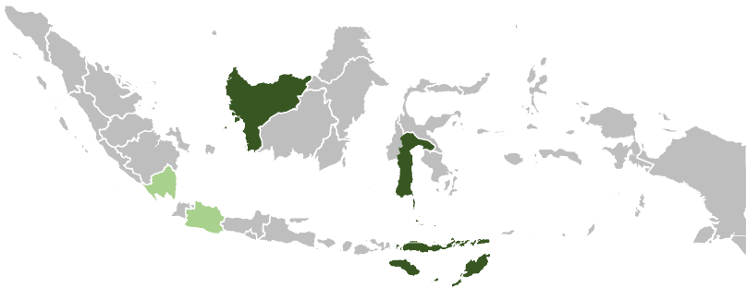

Roadmap to Responsible Organisational Profitability Increase
Division of strategies in phases for implementation
FinTech Collaborations
and Operational Changes
Province Expansion and Irrigation Facility
1
West
Kalimanthan
East Nusa
Tenggara
South
Sulawesi
Collaborate with TBOP to optimize operations
Allow flexible lending amounts
Modified credit score
ratings
2
Country wide
expansion
PROVINCE EXPANSION
These regions have higher total and female population in the rural areas
Agriculture is the prominent occupation
Absence of major MFIs
Absence of civil conflicts
IRRIGATION FACILITY
Introduction of Subak’s to enhance the current irrigation facilities under Asset Lending aspect of Flexible Lending
Expand to the other provinces of Indonesia to expand consumer base
Make more Subak’s to in other provinces to meet irrigation requirements
3
OVERVIEW FINTECH
CREDIT RATINGS
ALTERNATE LENDING
SUBAKS
TIMELINE
RISK MITIGATIONS
FINANCIALS

Slide 7

Mitra Kredit
Optimizing the operations of UFH to make microfinance more accessible
1
2
3
4
Modern Subak
FinTech Collaborations
Credit Ratings
Alternate Lending

Slide 8

















Potential FinTech Collaborations
Comparing and contrasting various services on key metrics
Companies
Low Bandwidth Productivity
Automated upgradation
MIS efficiency
User Friendly
Cost
OVERVIEW
FINTECH
CREDIT RATINGS
ALTERNATE LENDING
SUBAKS
TIMELINE
RISK MITIGATIONS
FINANCIALS

Slide 9
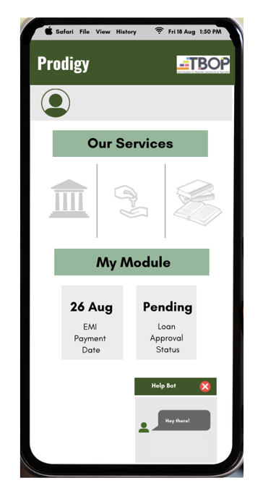
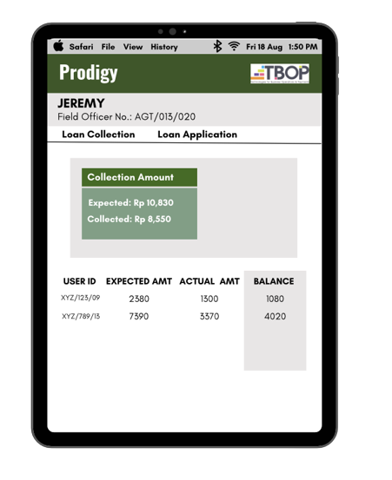


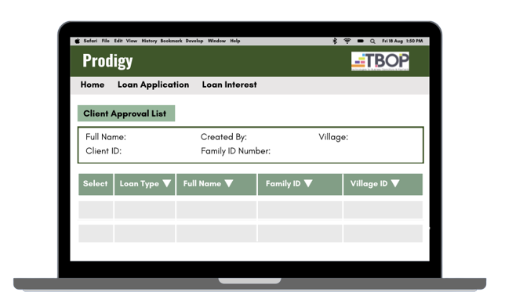

Prodigy: TBOP's financial services software for MFIs
Outline of interface and features of the Indonesian-centric platform
Boots on the Ground Approach
Low Bandwidth
Audit Trails
Developers made significant number of visits to observe the day-to-day workings of the field officer to design the MIS
Two flow obstacles were identified: operations of field offers and connecting field officers to central database
The program is designed to work on HTML so they can be deployed on tablets with web browser
Receipts printed with the help of Bluetooth printers and data is synchronized using physical networks
Loan Seeker
Field Officer
All entries made are recorded with the User ID, FO ID and Employee ID along with time stamps to ensure transparency
The electronic data reduces scope for manual error and makes the process easier to audit
Decision Terminal
OVERVIEW FINTECH
CREDIT RATINGS ALTERNATE LENDING SUBAKS TIMELINE
RISK MITIGATIONS
FINANCIALS

Slide 10









Prodigy: TBOP's financial services software for MFIs
Digitisation from grass-root level to increase efficiency and reduce loan application time
Active Server
General Public Field Officer
Locality A
Terminals
Bank Office
Stand-by Server
Locality B
Bank Office
Terminals
General Public
Field Officer
Process
Ground-work Aid | Decision Terminal Aid | Data Back-up Aid
The field officer visits a locality with a tablet | Bank offices store the data collected by the | Data is stored in two main databases which
to collect interests or loan applications in order to prevent any manual error
Receipts are given through Bluetooth connected printers to ensure accountability
field officer
This data is then used to maintain the database of all the users in the locality and helps in making decision e.g. determination of credit score
ALTERNATE LENDING SUBAKS
regularly transfer data to each other
This transfer ensures that in case of data loss from any one database, the data from the other one can be used and sent back via a back-up route
OVERVIEW
FINTECH
CREDIT RATINGS
TIMELINE
RISK MITIGATIONS
FINANCIALS

Slide 11
Mitra Kredit
Optimizing the operations of UFH to make microfinance more accessible
1
2
3
4
FinTech Collaboration
Credit Ratings
Alternate Lending
Modern Subak

Slide 12
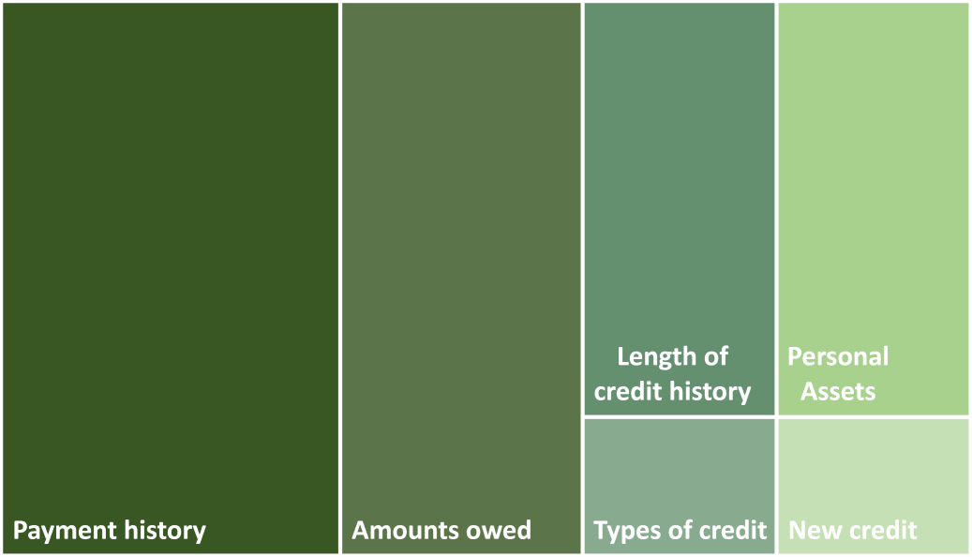








Traditional vs Contemporary Credit Systems
Identifying and rectifying the shortcomings of the current credit system
Current Credit System (A)
New Model
0.5*A
+
0.2*B
+
0.3*SEUR
Helps assess the financial soundness behind lending the loan
Gauges the earning capacity and financial responsibility
Incorporates your soc io-economic privilege and background.
 | Literacy Ratings (B)
Levels |  | Weights
No Formal Education |  | 0
Finished Secondary School |  | 1
Finished High School |  | 2
Pursued Higher Education |  | 3
Lacks Literacy
Aspect
Potential Earning
Lack of Standardization
Lack of Transparency
There exists a direct negative correlation between financial literacy rates and default rates
Therefore, weight would be assigned each level of education which will then subsequently be showed in the credit score
Literate loan takers are more likely to be more financial responsible by not defaulting
Doesn’t take into account the increase in earning after taking the loan
Most banks and credit bureaus use different methods to determine credit scores
The process behind determining credit scores is not revealed to loan seekers
OVERVIEW
FINTECH
CREDIT RATINGS
ALTERNATE LENDING
SUBAKS
TIMELINE
RISK MITIGATIONS
FINANCIALS

Slide 13
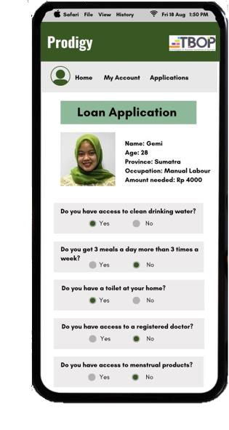


SEUR: The Socio-Economic Underprivilege Ratio
UFH aims to be profitable while servicing underprivileged households who have little access to financial services
(MW + EW)*[Net Income * (
)]
Scored on a scale of 0.5 to 1. Relative to income levels in an area.
Rich and upper-middle class: 0.5
Middle-class: 0.7
Lower-middle class: 0.8
BPL and Usually Poor: 0.9
Income
ECONOMIC
WEIGHT
SEUR =
Total Assets
Access to Basic Necessities
Relative to every area. Weights are inversely proportional to total population. This increases the SEUR of minorities. In Indonesia, all ethnicities can be broadly categorized within 6 categories.
Calculation = 0.5 * (1 - % of the minority in total pop.)
SEUR
MINORITY
WEIGHT
Existing
MW = 0.5*(1-0.0743) = 0.46285 EW = 0.8
Net Income = 6,000 Income = 13,000 Total Assets = 25,000
[(2*3)+(1*2)]
No provision for evaluation of socio-economic background
Access to Basic Necessities is assessed by gauging the individual's ease of obtaining essentials like food, water, shelter, healthcare, and education.
No effect on the credit score
ACCESS TO BASIC
NECESSITIES
ABN = 1.6 =
5
SEUR = 39.40%
This is derived from loan application responses, averaging answers to five objective (Yes or No) questions, with scores of 1 or 2. A lower access results in a lower score and a higher SEUR, contributing to an elevated credit rating.
The socio-economic background of the loan applicant is
considered as a factor while evaluating the credit score.
CONCLUSION
UFH aims to be profitable while being equitable in its activities. Existing measures of credit scoring are limited in their scope while incorporating socio-economic measures. SEUR is a measure of levelling the socio-economic hierarchy. It make loans more accessible to the underprivileged.
Net Income: The person’s income after deducting their
expenses.
Income: This is the person’s total income from all sources.
Asset-to-income ratio: This is the ratio of the person's assets to their income.
OTHER
TERMS
OVERVIEW FINTECH CREDIT RATINGS
ALTERNATE LENDING
SUBAKS
TIMELINE RISK MITIGATIONS
FINANCIALS

Slide 14










Credit Score Mapping
Consumer routes for different credit score alternatives
Flexible Lending
Instead of the set loan amounts, a smaller amount can be given in order to make it easier to repay
Intan gets a loan of Rp 2500 instead of the UFH’s set offering of Rp 3500
Low Credit Score
Name: Intan
Gender: Female
Loan Amount: Rp 2500 Occupation: Basket-weaver Reason for loan: To purchase raw materials to sell Canang Sari
The person has a lower credit rating and can be given two options to further improve his credit rating
Group Borrowing
Loans are issued to groups instead of individuals to increase accountability of all members
Intan approaches the bank along with other basket weavers to get a loan as a group to produce for Canang Sari
Credit Score
Ratings
High Credit Score
Name: Abyasa
Gender: Male
Loan Amount: Rp 15000 Occupation: Medium-sized farmer Reason for loan: Temporarily increase the yield for Nusantara fruit festivals
The person is granted the required loan amount and the repayment process would be normal
RATIONALE
OUR CREDIT SYSTEM
We aim to improve the credit rating of low rated customers
DEFAULT RATE
IMPACT
Decrease default rates by providing group borrowing and flexible lending
Economic
Factors
Social Factors
OVERVIEW
FINTECH
CREDIT RATINGS
ALTERNATE LENDING
SUBAKS
TIMELINE
RISK MITIGATIONS
FINANCIALS

Slide 15
Mitra Kredit
Optimizing the operations of UFH to make microfinance more accessible
1
2
3
4
Alternate Lending
Credit Ratings
Alternative Lending
Modern Subak

Slide 16






















Alternate Lending
Holistic approaches to reduce default rates
Flexible Lending
Amount
Interest
Beneficiary
1
2
Lending Amounts
Individual Loans
Rp 2000-5000
22.5%
Small farmers
Small
Enterprises
Rp 5000-7000
22.5%
Business Owners
Citra’s loan gets denied due to poor credit score
Citra approaches other people to get a loan together
Established Clients*
Rp 7000-15000
15-
22.5%
Long-term clients
4
3
* Apply to only Sumatra and Java till FY 27
Harvesting
The banks approves the loan due to increased accountability of a group
Phase 2
The successful repayment of loans caused higher credit score possibilities for all members
Asset Lending
Irrigation
Ploughing
Farming Equipment
GROUP BORROWING
People are less likely to default in case they are borrowing with a group of other people they know due to social pressure
In case any person in the group defaults the future borrowing capacity of the whole group is reduced
Currently, most provinces use traditional farming methods and rainfall farming
Due to high cost of equipment, farmers can’t increase productivity with newer technology
Equipment can be leased to these farmers for a given time frame along with training to use them safely
OVERVIEW FINTECH
CREDIT RATINGS
ALTERNATE LENDING
SUBAKS
TIMELINE RISK MITIGATIONS
FINANCIALS

Slide 17
Mitra Kredit
Optimizing the operations of UFH to make microfinance more accessible
1
2
3
4
FinTech Collaboration
Credit Ratings
Alternate Lending
Modern Subak

Slide 18




Modernising Subaks: Revitalising a traditional irrigiation system
Farmers in Indonesia typically depend on rainfall and most of them do not have access to costly modern irrigation practices
INTRODUCTION
IMPACT
INCENTIVES
Farmers typically dependent on rainfall for their water needs.
IMPROVED YIELD LEADING TO HIGHER PROFITS FOR FARMERS
Higher productivity due to availability of water during dry seasons.
Effects of climate change being felt in the form of irregular rain patter throughout the year.
INSTRUMENT
Lower chances of default since produce is ensured to a certain extent.
Government schemes have largely been unsuccessful due to interruption to traditional systems and non-cooperation by farmers.
INDIVIDUAL LOANS
Efficient in both the manpower and energy requirements as compared to modern practices.
Modernized Subaks merge the concept of a cyclical water reservoir with a community based irrigation system. Increases cooperation and certainty as well.
COST
AVERAGE INTEREST AMOUNT: 3500
IDR / LITRE
Lower chances of default since produce is ensured to a certain extent.
15 farms per Subak, and 3 Subaks to be built.
PROCESS
INTRODUCTION
STORAGE
MEETINGS
INCENTIVISING
FINANCE
REPAYMENTS
Select areas where Subaks are to be introduced using 3 variables: geographical location, , and external threat.
Water inlet is started around the month of December, is stored until the month of June and is then distributed
Meetings where we introduce this technology and discuss it with the farmers
Incentivising farmers to use the technology in dry seasons
Providing irrigation facilities at affordable rates.
Higher incomes leads to a lower probability of default.
OVERVIEW
FINTECH
CREDIT RATINGS
ALTERNATE LENDING
SUBAKS
TIMELINE
RISK MITIGATIONS
FINANCIALS

Slide 19
Impact Assessment
Gauging the impact of Mitra Kredit over the years FY24-FY28

Slide 20

Timeline
Year wise implementation with feedback and corrective blocks of Mitra Kredit
 | 2023 | 2024 | 2025 | 2026 | 2027 | 2028 | 2029 2030
Phase I
Flexible Loans Group Loans
TBOP collab Credit rating revolution
Phase II
Expansion in 3 provinces
3 Subaks developed
Leasing out
agricultural tools
Phase III
Expansion in other provinces of Indonesia
More Subaks developed
Prelaunch
Phase of Operation
Feedback
Correction
OVERVIEW
FINTECH
CREDIT RATINGS
ALTERNATE LENDING
SUBAKS
TIMELINE
RISK MITIGATIONS
FINANCIALS

Slide 21
Risk Mitigation
Using a to-down approach to identify risks and developing corrective measures
RISK
MITIGATION
5
Adaptation
Easier Interface
Providing user-friendly interfaces and field officers can initially help people apply for loans and navigate the platform
1technology and fintech platforms which might
The rural population has limited experience in
1
result in difficulty in adapting to TBOP
4
Competitors
The provinces we are expanding to might have existing MFIs which have a working relationship with the people
Less time and Fintech
With the collaboration with TBOP the loan application process would be simplified and the credit score system would allow for differentiation and equitable loan distribution
2
3
2
Impact
Inaccurate data about ABN People might lie to us in the form about ABN to try and get a better credit rating and themselves as socially vulnerable
Correlation between Net Income and ABN A person having less ABN would ideally also have lesser access to resources. Home checks by field officers would also give an accurate
picture about ABN
2
3
3
4
1
Contamination
Storing water in Subak could lead to a risk of contamination of water thus making it unusable
Rotation and Treatment
We can forecast the demand of water based on the agricultural seasons and rotate the supply every 6 months while treating it continuously
4
0
1
2
3
4
5
Likelihood
OVERVIEW
FINTECH
CREDIT RATINGS
ALTERNATE LENDING
SUBAKS
TIMELINE
RISK MITIGATIONS
FINANCIALS

Slide 22
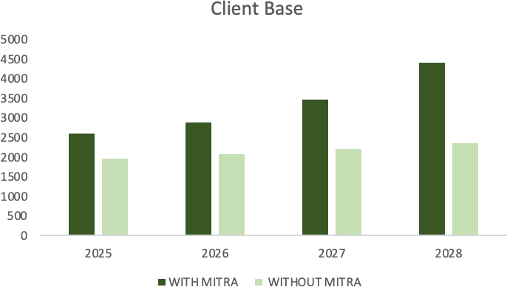





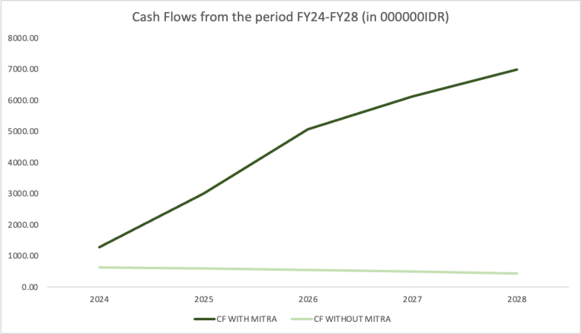
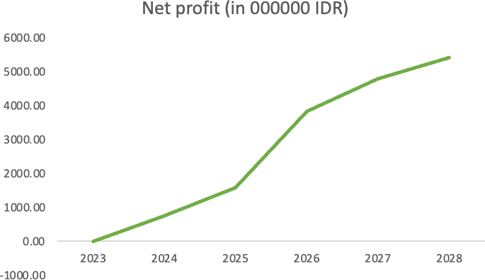
Financial Impact
Assessing the economic feasibility for the next 5 year
PROJECTED GROWTH OVER 5 YEAR PERIOD
1
3
+2064
Users by 2028
20.95%
CAGR (24-28)
2
+5416.16
Net Profit in
FY 28
OVERVIEW
FINTECH
CREDIT RATINGS
ALTERNATE LENDING
SUBAKS
TIMELINE
RISK MITIGATIONS
FINANCIALS

Slide 23
Thank You!

Slide 24
Appendix
Assessing the feasibility of the proposed solutions

Slide 25
APPENDIX
Index
S. No. | Topic
1 | Income Expenditure
2 | Overall Admin Cost
3 | Java and Sumatra Employee Cost
4 | Cash Flow and NPV Calculation
5 | CAPM and Terminal Value Calculation
6 | Cash Flow estimation without Mitra
7 | Employee Cost in New Provinces
8 | Potential Client base estimation
9 | Modern Subak Model
10 | Sources

Slide 26
APPENDIX
Financials: Income Statement post effect of Mitra Kredit
WITH MITRA KREDIT
Income Statement
 |  |  | ACTUAL |  |  |  | ESTIMATED
Particulars | FY19 | FY20 | FY21 | FY22 | FY23 | FY24 (E) | FY25 (E) | FY26 (E) | FY27 (E) | FY28 (E)
Interest Revenue | 2011.00 | 1876.00 | 2043.00 | 2094.00 | 2143.00 | 2391.18 | 3886.02 | 4870.53 | 5964.59 | 7672.51
Other Revenue (Donations/Gains) | 46.00 | 35.00 | 51.00 | 45.00 | 42.00 | 43.82 | 45.79 | 47.92 | 50.22 | 52.74
Income from Subak | 0.00 | 0.00 | 0.00 | 0.00 | 0.00 | 2205.00 | 2205.00 | 2205.00 | 2205.00 | 2205.00
Revenue | 2057.00 | 1911.00 | 2094.00 | 2139.00 | 2185.00 | 4640.00 | 6136.81 | 7123.46 | 8219.82 | 9930.25
Employee costs | 1511.00 | 1690.00 | 1610.00 | 1649.00 | 1734.00 | 2167.04 | 3496.93 | 2131.79 | 2148.96 | 3066.54
Administrative Expenses | 93.00 | 97.00 | 101.00 | 121.00 | 143.00 | 140.95 | 136.94 | 348.46 | 364.76 | 382.55
Transport & Communication | 72.00 | 60.00 | 76.00 | 80.00 | 86.00 | 89.72 | 93.76 | 98.13 | 102.84 | 107.98
Provision for loan losses | 101.00 | 193.00 | 111.00 | 134.00 | 151.00 | 168.49 | 273.82 | 343.19 | 420.28 | 540.62
Collaboration with TBOP | 0.00 | 0.00 | 0.00 | 0.00 | 0.00 | 1247.20 | 129.51 | 86.67 | 90.47 | 102.16
Hardware (devices for each officer @ 4.8) | 0.00 | 0.00 | 0.00 | 0.00 | 0.00 | 211.99 | 0.00 | 0.00 | 0.00 | 0.00
Platform acquisition cost | 0.00 | 0.00 | 0.00 | 0.00 | 0.00 | 957.88 | 0.00 | 0.00 | 0.00 | 0.00
Data connectivity subscription fee (0.5 per employee) | 0.00 | 0.00 | 0.00 | 0.00 | 0.00 | 77.34 | 129.51 | 86.67 | 90.47 | 102.16
Subak construction | 0.00 | 0.00 | 0.00 | 0.00 | 0.00 | 0.00 | 209.38 | 0.00 | 0.00 | 0.00
Subak Maintenance Cost |  |  |  |  |  | 0.00 | 0.00 | 69.10 | 69.10 | 69.10
Other expenses | 56.00 | 71.00 | 61.00 | 68.00 | 78.00 | 81.38 | 212.60 | 222.51 | 233.19 | 244.85
Total Expenses | 1833.00 | 2111.00 | 1959.00 | 2052.00 | 2192.00 | 3894.78 | 4552.94 | 3299.84 | 3429.59 | 4513.79
Total Profit or Loss | 224.00 | -200.00 | 135.00 | 87.00 | -7.00 | 745.22 | 1583.87 | 3823.62 | 4790.23 | 5416.46
TBOP collaboration cost
These costs are ascertained by taking a proxy for the Artoo case study 2015 in which Ujjiwan, an Indian MFI collaborated with Artoo, a software based cloud storage firm to digitalise their operations
Source
https://artoo.com/Accion-Case-Study.pdf

Slide 27
APPENDIX
Financials: Income Statement post effect of Mitra Kredit
Particulars | FY19 | FY20 | FY21 | FY22 | FY23 | FY24 (E) | FY25 (E) | FY26 (E) | FY27 (E) | FY28 (E)
Outreaching clients | 113.00 | 109.00 | 115.00 | 121.00 | 135.00 | 144.45 | 357.06 | 420.33 | 581.06 | 853.67
(Java & Sumatra) | 113.00 | 109.00 | 115.00 | 121.00 | 135.00 | 144.45 | 154.56 | 166.93 | 181.95 | 200.14
(South Sulawesi, West Kalimantan, East Nusa) | 0.00 | 0.00 | 0.00 | 0.00 | 0.00 | 0.00 | 202.50 | 253.41 | 399.11 | 653.52
Collecting interest | 81.00 | 92.00 | 87.00 | 102.00 | 121.00 | 222.66 | 185.90 | 120.48 | 109.30 | 140.42
(Java & Sumatra) | 81.00 | 92.00 | 87.00 | 102.00 | 121.00 | 222.66 | 156.25 | 90.83 | 85.58 | 101.18
(South Sulawesi, West Kalimantan, East Nusa) | 0.00 | 0.00 | 0.00 | 0.00 | 0.00 | 0.00 | 29.65 | 29.65 | 23.72 | 39.24
Loan application process & Managing clients | 1087.00 | 1257.00 | 1167.00 | 1177.00 | 1219.00 | 1474.00 | 2377.03 | 1307.79 | 1188.80 | 1719.24
(Java & Sumatra) | 1087.00 | 1257.00 | 1167.00 | 1177.00 | 1219.00 | 1474.00 | 718.18 | 418.13 | 488.20 | 572.04
(South Sulawesi, West Kalimantan, East Nusa) | 0.00 | 0.00 | 0.00 | 0.00 | 0.00 | 0.00 | 1658.85 | 889.66 | 700.60 | 1147.19
General admin | 156.00 | 161.00 | 165.00 | 174.00 | 181.00 | 218.86 | 458.51 | 194.18 | 176.52 | 255.28
(Java & Sumatra) | 156.00 | 161.00 | 165.00 | 174.00 | 181.00 | 218.86 | 106.64 | 62.08 | 72.49 | 84.94
(South Sulawesi, West Kalimantan, East Nusa) | 0.00 | 0.00 | 0.00 | 0.00 | 0.00 | 0.00 | 351.87 | 132.10 | 104.03 | 170.34
Employee Training Programme | 0.00 | 0.00 | 0.00 | 0.00 | 0.00 | 25.68 | 33.38 | 0.00 | 0.00 | 0.00
(Java & Sumatra) | 0.00 | 0.00 | 0.00 | 0.00 | 0.00 | 25.68 | 0.00 | 0.00 | 0.00 | 0.00
(South Sulawesi, West Kalimantan, East Nusa) | 0.00 | 0.00 | 0.00 | 0.00 | 0.00 | 0.00 | 33.38 | 0.00 | 0.00 | 0.00
Other | 74.00 | 71.00 | 76.00 | 75.00 | 78.00 | 81.38 | 85.04 | 89.00 | 93.27 | 97.94
Employee costs | 1511.00 | 1690.00 | 1610.00 | 1649.00 | 1734.00 | 2167.04 | 3496.93 | 2131.79 | 2148.96 | 3066.54
Utilities | 21.00 | 15.00 | 24.00 | 23.00 | 26.00 | 27.13 | 28.35 | 74.17 | 77.73 | 81.62
Rent | 30.00 | 28.00 | 31.00 | 31.00 | 33.00 | 34.43 | 35.98 | 94.14 | 98.66 | 103.59
Storage space for physical filings | 24.00 | 24.00 | 24.00 | 24.00 | 24.00 | 16.80 | 7.20 | 9.00 | 9.00 | 9.00
Insurance | 14.00 | 19.00 | 19.00 | 20.00 | 20.00 | 20.87 | 21.80 | 57.05 | 59.79 | 62.78
Other | 4.00 | 11.00 | 3.00 | 23.00 | 40.00 | 41.73 | 43.61 | 114.11 | 119.58 | 125.56
Administrative expenses | 93.00 | 97.00 | 101.00 | 121.00 | 143.00 | 140.95 | 136.94 | 348.46 | 364.76 | 382.55

Slide 28
APPENDIX
Financials: Income statement before Mitra Kredit
WITHOUT MITRA KREDIT
Income Statement
Particulars | FY19 | FY20 | FY21 | FY22 | FY23 | FY24E | FY25E | FY26E | FY27E | FY28E
Interest Revenue | 2011 | 1876 | 2043 | 2094 | 2143 | 2193.147 | 2244.467 | 2296.988 | 2350.738 | 2405.745
Other Revenue (Donations/Gains) | 46 | 35 | 51 | 45 | 42 | 43.82 | 45.79 | 47.92 | 50.22 | 52.74
Revenue | 2057 | 1911 | 2094 | 2139 | 2185 | 2236.965 | 2290.257 | 2344.912 | 2400.962 | 2458.481
Employee costs | 1511 | 1690 | 1610 | 1649 | 1734 | 1826.275 | 1923.459 | 2025.816 | 2133.619 | 2247.16
Administrative Expenses | 93 | 97 | 101 | 121 | 143 | 179.0856 | 237.6534 | 334.9244 | 499.0661 | 779.0176
Transport & Communication | 72 | 60 | 76 | 80 | 86 | 92.45 | 99.38375 | 106.8375 | 114.8503 | 123.4641
Provision for loan losses | 101 | 193 | 111 | 134 | 151 | 170.1567 | 191.7438 | 216.0695 | 243.4813 | 274.3707
Other expenses | 56 | 71 | 61 | 68 | 78 | 89.47059 | 102.628 | 117.7204 | 135.0322 | 154.8899
Total Expenses | 1833 | 2111 | 1959 | 2052 | 2192 | 2357.437 | 2554.868 | 2801.368 | 3126.049 | 3578.902
Total Profit or Loss | 224 | -200 | 135 | 87 | -7 | -120.472 | -264.611 | -456.456 | -725.087 | -1120.42
Outreaching clients | 113 | 109 | 115 | 121 | 135 | 150.6198 | 168.0469 | 187.4904 | 209.1835 | 233.3865
Managing clients | 305 | 331 | 376 | 380 | 401 | 423.1605 | 446.5457 | 471.2232 | 497.2645 | 524.7449
Collecting interest | 81 | 92 | 87 | 102 | 121 | 143.5392 | 170.2769 | 201.9952 | 239.6217 | 284.2571
Loan application process | 782 | 926 | 791 | 797 | 818 | 839.5533 | 861.6746 | 884.3787 | 907.681 | 931.5973
General admin | 156 | 161 | 165 | 174 | 181 | 188.2816 | 195.8562 | 203.7354 | 211.9317 | 220.4577
Other | 74 | 71 | 76 | 75 | 78 | 81.12 | 84.3648 | 87.73939 | 91.24897 | 94.89893
Employee costs | 1511.00 | 1690 | 1610 | 1649 | 1734 | 1826.275 | 1923.459 | 2025.816 | 2133.619 | 2247.16
Utilities | 21 | 15 | 24 | 23 | 26 | 29.3913 | 33.22495 | 37.55864 | 42.4576 | 47.99554
Rent | 30 | 28 | 31 | 31 | 33 | 35.12903 | 37.39542 | 39.80803 | 42.37629 | 45.11024
Storage space for physical filings | 24 | 24 | 24 | 24 | 24 | 24 | 24 | 24 | 24 | 24
Insurance | 14 | 19 | 19 | 20 | 20 | 21 | 22.05 | 23.1525 | 24.31013 | 25.52563
Other | 4 | 11 | 3 | 23 | 40 | 69.56522 | 120.983 | 210.4052 | 365.9221 | 636.3862
Administrative expenses | 93 | 97 | 101 | 121 | 143 | 179.0856 | 237.6534 | 334.9244 | 499.0661 | 779.0176

Slide 29
APPENDIX
Financials: Administrative Expense Forecast (Java and Sumatra)
STORAGE SPACE FOR PHYSICAL FILINGS
FY23 | FY24 (E) | FY25 (E) | FY26 (E) | FY27 (E) | FY28 (E)
24.00 | 16.80 | 7.20 | 9.00 | 9.00 | 9.00
RENT
FY23 | FY24 (E) | FY25 (E) | FY26 (E) | FY27 (E) | FY28 (E)
33.00 | 34.43 | 35.98 | 94.14 | 98.66 | 103.59
INSURANCE
FY23 | FY24 (E) | FY25 (E) | FY26 (E) | FY27 (E) | FY28 (E)
20.00 | 20.87 | 21.80 | 57.05 | 59.79 | 62.78
EMPLOYEE TRAINING PROGRAMME
FY23 | FY24 (E) | FY25 (E) | FY26 (E) | FY27 (E) | FY28 (E)
0.00 | 0.00 | 0.00 | 113.63 | 0.00 | 0.00
UTILITIES
FY23 | FY24 (E) | FY25 (E) | FY26 (E) | FY27 (E) | FY28 (E)
26.00 | 27.13 | 28.35 | 74.17 | 77.73 | 81.62
OTHERS
FY23 | FY24 (E) | FY25 (E) | FY26 (E) | FY27 (E) | FY28 (E)
40.00 | 41.73 | 43.61 | 114.11 | 119.58 | 125.56
INFLATION RATES
FY23 | FY24 (E) | FY25 (E) | FY26 (E) | FY27 (E) | FY28 (E)
0.0000 | 0.0433 | 0.0450 | 0.0466 | 0.0480 | 0.0500

Slide 30
APPENDIX
Financials: Number of Employees and Outreaching Cost Related to them in Java and Sumatra
NO. OF EMPLOYEES PER FIRM (JAVA AND SUMATRA)
 | FY23 | FY24 (E) | FY25 (E) | FY26 (E) | FY27 (E) | FY28 (E)
Total Employees | 15 | 19 | 13 | 9 | 10 | 11
Outreaching Clients | 2 | 2 | 2 | 2 | 3 | 3
Collecting Interest | 3 | 6 | 4 | 2 | 2 | 3
Managing and Loan Application Process | 5 | 6 | 3 | 2 | 2 | 2
General admin | 3 | 4 | 2 | 1 | 1 | 1
Others | 2 | 2 | 2 | 2 | 2 | 2
 | CLIENT BASE | APPLIED | ACCEPTED
2023 | 1776 | 329 | 191
2024 | 1900 | 568 | 391
2025 | 2033 | 646 | 456
2026 | 2196 | 752 | 549
2027 | 2394 | 878 | 659
2028 | 2633 | 1029 | 790
No. of offices (per province) | 4
No. of provinces | 2
Total offices | 8
FY 23
Outreaching Employees | 16
No. of Clients | 1776
No. of clients/employee | 111
FY 24
Outreaching Employees | 17
No. of Clients | 1900
No. of clients/employee | 111
OUTREACHING EMPLOYEES
FY23 | FY24 (E) | FY25 (E) | FY26 (E) | FY27 (E) | FY28 (E)
135.00 | 144.45 | 154.56 | 166.93 | 181.95 | 200.14
FY 25
Outreaching Employees | 18
No. of Clients | 2033
No. of clients/employee | 111
FY 26
Outreaching Employees | 20
No. of Clients | 2196
No. of clients/employee | 111
Rationale
FY 27
Outreaching Employees | 22
No. of Clients | 2394
No. of clients/employee | 111
FY 28
Outreaching Employees | 24
No. of Clients | 2633
No. of clients/employee | 111
The number of employees in an MFI have been taken as 75 for the base year. The future costs incurred depends on the number of employees taking the efficiency of each employee
to be constant

Slide 31
APPENDIX
Financials: Expenditure related to collecting interest in Java and Sumatra
FY 23
Employees | 24
No. of Clients | 191
No. of clients of physical loans | 191
No. of clients/emp | 8
FY 24
Employees | 44
No. of Clients | 391
No. of clients of physical loans | 351
No. of clients/emp | 8
FY 25
Employees | 31
No. of Clients | 456
No. of clients of physical loans | 247
No. of clients/emp | 8
FY 26
Employees | 18
No. of Clients | 549
No. of clients of physical loans | 143
No. of clients/emp | 8
COLLECTING INTERESTS
FY23 | FY24 (E) | FY25 (E) | FY26 (E) | FY27 (E) | FY28 (E)
121.00 | 222.66 | 156.25 | 90.83 | 85.58 | 101.18
FY 27
Employees | 17
No. of Clients | 659
No. of clients of physical loans | 135
No. of clients/emp | 8
FY 28
Employees | 20
No. of Clients | 790
No. of clients of physical loans | 160
No. of clients/emp | 8
Rationale
Rational: The no. of physical loans would decrease subsequently over the periods because of the collaboration with TBOP but would remain fixed after a certain time period because people won't switch to TBOP. This cost depends on the number of accepted loans

Slide 32
APPENDIX
Financials: Expenditure related to loan application process in Java and Sumatra
FY 23
Employees | 40
No. of Clients | 329
No. of clients of physical loans | 329
No. of clients/emp | 8
FY 24
Employees | 48
No. of Clients | 568
No. of clients of physical loans | 398
No. of clients/emp | 8
MANAGING AND LOAN APPLICATION PROCESS
FY23 | FY24 (E) | FY25 (E) | FY26 (E) | FY27 (E) | FY28 (E)
1219.00 | 1474.00 | 718.18 | 418.13 | 488.20 | 572.04
FY 25
Employees | 24
No. of Clients | 646
No. of clients of physical loans | 194
No. of clients/emp | 8
FY 26
Employees | 14
No. of Clients | 752
No. of clients of physical loans | 113
No. of clients/emp | 8
FY 27
Employees | 16
No. of Clients | 878
No. of clients of physical loans | 132
No. of clients/emp | 8
FY 28
Employees | 19
No. of Clients | 1029
No. of clients of physical loans | 154
No. of clients/emp | 8
Rationale
Rational: The no. of physical loans would decrease subsequently over the periods because of the collaboration with TBOP, signifcantly declining the no. of employees but would remain fixed after a certain time period. This cost depends on number of applied loans

Slide 33
APPENDIX
Financials: Expenditure related to general admin and others in Java and Sumatra
FY 23
Employees | 24
No. of Clients | 329
No. of clients of physical loans | 329
No. of clients/emp | 14
FY 24
Employees | 29
No. of Clients | 568
No. of clients of physical loans | 398
No. of clients/emp | 14
GENERAL ADMIN
FY23 | FY24 (E) | FY25 (E) | FY26 (E) | FY27 (E) | FY28 (E)
181.00 | 218.86 | 106.64 | 62.08 | 72.49 | 84.94
Rationale
FY 25
Employees | 14
No. of Clients | 646
No. of clients of physical loans | 194
No. of clients/emp | 14
FY 26
Employees | 8
No. of Clients | 752
No. of clients of physical loans | 113
No. of clients/emp | 14
Rational: The no. of clients of physical loans would decrease over time declining the general admin costs
FY 28
Employees | 11
No. of Clients | 1029
No. of clients of physical loans | 154
No. of clients/emp | 14
OTHERS
FY23 | FY24 (E) | FY25 (E) | FY26 (E) | FY27 (E) | FY28 (E)
78.00 | 81.38 | 85.04 | 89.00 | 93.27 | 97.94
FY 27
Employees | 10
No. of Clients | 878
No. of clients of physical loans | 132
No. of clients/emp | 14
Rationale
Rational: The no. of employees per firm would remain the same and thus total cost is assumed to increase with respect to inflation

Slide 34
APPENDIX
Financials: NPV calculations with Mitra
Years | FY24 (F) | FY25 (F) | FY26 (F) | FY27 (F) | FY28 (F)
Interest Income Earned (In IDR Mn)
With Mitra Kredit | 4596.18 | 6091.02 | 7075.53 | 8169.59 | 9877.51
Cash Flows From Lending | 4596.18 | 6091.02 | 7075.53 | 8169.59 | 9877.51
Salary and Wages (In IDR Mn)
With Mitra Kredit | 1841.12 | 2920.00 | 1848.60 | 1879.17 | 2713.32
Cash Flows After Adjusting for Salary and Wages | 2755.07 | 3171.02 | 5226.93 | 6290.42 | 7164.19
Employee Training Costs (In IDR Mn) | 25.68 | 33.38 | 0.00 | 0.00 | 0.00
Collaboration with TBOP (In IDR Mn) | 1247.20 | 129.51 | 86.67 | 90.47 | 102.16
Subak Construction (In IDR Mn) | 209.38 | 0.00 | 0.00 | 0.00 | 0.00
Subak Maintenance Cost (In IDR Mn) | 0.00 | 0.00 | 69.10 | 69.10 | 69.10
Total | 1482.27 | 162.89 | 155.76 | 159.57 | 171.26
Net Cash Flow | 1272.80 | 3008.13 | 5071.17 | 6130.86 | 6992.94
Years | FY24 (F) | FY25 (F) | FY26 (F) | FY27 (F) | FY28 (F)
Cash Flows | 1272.80 | 3008.13 | 5071.17 | 6130.86 | 6992.94
Disc Rate | 1.079832 | 1.166037 | 1.259124 | 1.359642631 | 1.468185622
Present Value | 1178.701826 | 2579.786 | 4027.535 | 4509.167787 | 4762.977876

Slide 35
APPENDIX
Financials: CAPM and Terminal Value calculations with Mitra
Cost of Equity
Risk Free Rate | 6.41%
Beta | 0.36
Country Risk Premium | 2.89%
Indonesia ERP | 7.89%
Cost of Equity (CAPM) | 7.98%
Only equity in the financial structure so only the Cost of Equity calculated. All measures taken from the website of Aswath Damodaran
Terminal Value (In IDR Mn)
FCFF (Last) | 6992.94
Growth Rate | 5%
CAPM | 7.98%
Terminal Value | 275484.83
PV of Terminal Value (NPV) | 173764.29
Years | FY24 (F) | FY25 (F) | FY26 (F) | FY27 (F) | FY28 (F)
FCF | 1178.70 | 2579.79 | 4027.53 | 4509.17 | 4762.98
Terminal Value |  |  |  |  | 173764.29
Total |  |  |  |  | 178527.27
CAGR of FCFF 32.22%

Slide 36
APPENDIX
Financials: Cash flow estimation without Mitra
Years | FY24 (F) | FY25 (F) | FY26 (F) | FY27 (F) | FY28 (F)
Interest Income Earned (In IDR Mn)
Without Mitra Kredit | 2193.147 | 2244.467 | 2296.988 | 2350.738 | 2405.745
Cash Flows From Lending | 2193.147 | 2244.467 | 2296.988 | 2350.738 | 2405.745
Salary and Wages (In IDR Mn) | 1556.873 | 1646.544 | 1745.087 | 1853.751 | 1973.986
Without Mitra Kredit
Cash Flows After Adjusting for Salary and Wages | 636.2737 | 597.9226 | 551.9002 | 496.9869 | 431.7594

Slide 37
APPENDIX
Financials: Outreaching cost in 3 new provinces
 | CLIENT BASE | APPLIED | ACCEPTED
2025 | 640 | 138 | 85
2026 | 800 | 189 | 121
2027 | 1261 | 289 | 193
2028 | 2064 | 457 | 320
No. of offices (per province) | 4
No. of provinces | 3
Total offices | 12
FY 25
Outreaching Employees | 24
No. of Clients | 640
No. of clients/employee | 27
FY 27
Outreaching Employees | 47
No. of Clients | 1261
No. of clients/employee | 27
FY 26
Outreaching Employees | 30
No. of Clients | 800
No. of clients/employee | 27
FY 28
Outreaching Employees | 77
No. of Clients | 2064
No. of clients/employee | 27
OUTREACHING EMPLOYEES
FY23 | FY24 (E) | FY25 (E) | FY26 (E) | FY27 (E) | FY28 (E)
0.00 | 0.00 | 202.50 | 253.41 | 399.11 | 653.52
Rationale
Rational: The outreaching employees would increase from FY 23-30 due to increase in clients

Slide 38
APPENDIX
Financials: Collecting interest cost in 3 new provinces
COLLECTING INTERESTS
FY23 | FY24 (E) | FY25 (E) | FY26 (E) | FY27 (E) | FY28 (E)
0.00 | 0.00 | 29.65 | 29.65 | 23.72 | 39.24
FY 25 |  |  | FY 26
Employees | 36 |  | Employees | 22
No. of Clients | 85 |  | No. of Clients | 121
No. of clients of physical loans | 60 |  | No. of clients of physical loans | 36
No. of clients/emp | 2 |  | No. of clients/emp | 2
Rationale
Rational: The no. of physical loans would decrease subsequently over the periods because of the collaboration with Tbop but would remain fixed after a certain time period because people won't switch to TBOP. This cost depends on the number of accepted loans
FY 27 |  |  | FY 28
Employees | 17 |  | Employees | 29
No. of Clients | 193 |  | No. of Clients | 320
No. of clients of physical loans | 29 |  | No. of clients of physical loans | 48
No. of clients/emp | 2 |  | No. of clients/emp | 2
MANAGING AND LOAN APPLICATION PROCESS
FY23 | FY24 (E) | FY25 (E) | FY26 (E) | FY27 (E) | FY28 (E)
0.00 | 0.00 | 1658.85 | 889.66 | 700.60 | 1147.19
FY 25 |  |  | FY 26
Employees | 60 |  | Employees | 32
No. of Clients | 640 |  | No. of Clients | 800
No. of clients of physical loans | 448 |  | No. of clients of physical loans | 240
No. of clients/emp | 7 |  | No. of clients/emp | 7
FY 27 |  |  | FY 28
Employees | 25 |  | Employees | 41
No. of Clients | 1261 |  | No. of Clients | 2064
No. of clients of physical loans | 189 |  | No. of clients of physical loans | 310
No. of clients/emp | 7 |  | No. of clients/emp | 7
Rationale
Rational: The no. of physical loans would decrease subsequently over the periods because of the collaboration with TBOP, signifcantly declining the no. of employees but would remain fixed after a certain time period. This cost depends on number of applied loans

Slide 39
APPENDIX
Financials: General admin cost in 3 new provinces
FY 25 |  |  | FY 26
Employees | 36 |  | Employees | 14
No. of Clients | 640 |  | No. of Clients | 800
No. of clients of physical loans | 640 |  | No. of clients of physical loans | 240
No. of clients/emp | 18 |  | No. of clients/emp | 18
FY 27 |  |  | FY 28
Employees | 11 |  | Employees | 17
No. of Clients | 1261 |  | No. of Clients | 2064
No. of clients of physical loans | 189 |  | No. of clients of physical loans | 310
No. of clients/emp | 18 |  | No. of clients/emp | 18
GENERAL ADMIN
FY23 | FY24 (E) | FY25 (E) | FY26 (E) | FY27 (E) | FY28 (E)
0.00 | 0.00 | 351.87 | 132.10 | 104.03 | 170.34
Rationale
Rational: The no. of clients of physical loans would decrease over time declining the general admin costs
OTHERS
FY23 | FY24 (E) | FY25 (E) | FY26 (E) | FY27 (E) | FY28 (E)
0.00 | 0.00 | 212.60 | 222.51 | 233.19 | 244.85
TOTAL EXPENDITURE
FY23 | FY24 (E) | FY25 (E) | FY26 (E) | FY27 (E) | FY28 (E)
0.00 | 0.00 | 2455.47 | 1527.32 | 1460.65 | 2255.14
Rationale
Rationale
Rational: The no. of employees per firm would remain the same and thus total cost is assumed to increase with respect to inflation
Rational: The no. of employees per firm would remain the same and thus total cost is assumed to increase with respect to inflation

Slide 40
APPENDIX
Financials: Potential clients estimation in the new provinces
South Sulawesi |  | West Kalimantan | East Nusa Tenggara
Males | 4580221 | 2849410 | 2663771
Females | 4645526 | 2691966 | 2661795
Total | 9225747 | 5541376 | 5325566
Rural Population | 3773331 | 2266423 | 2178156
% people engaged in agriculture | 89.00% | 80.34% | 75.00%
No. of people engaged in agriculture | 3358264 | 1820844 | 1633617 0.88 88% of the total people engaged in agriculture since 12% of
No. of people engaged in agriculture (informal) | 2955272 | 1602343 | 1437583 the upper middle class is also engaged in agriculuture
No. of people not engaged in agriculture | 818058 | 664080 | 740573
2025 | South Sulawesi | West Kalimantan | East Nusa
Farmers requiring Credit | 1182109 | 640937 | 575033 | 40% require credit
Non Farmers requiring Credit (Women) | 163612 | 132816 | 148115 | 20% require credit
OUR POTENTIAL CLIENTS | 20186 | 11606 | 10847 | 1.50% | due to collab with TBOP gaining momentum and revolutionary credit system
FINAL PENETRATION | 40 | 23 | 22 | 0.20% | Conversion Rate due to increased credibility yet relatively unknown.
2026 | South Sulawesi | West Kalimantan | East Nusa
Farmers requiring Credit | 1182109 | 640937 | 575033 | Kept Constant
Non Farmers requiring Credit (Women) | 163612 | 132816 | 148115 | Kept Constant
OUR POTENTIAL CLIENTS | 22877 | 13154 | 12294 | 1.70% | due to the company building credibility but still being relatively unknown
FINAL PENETRATION | 57 | 33 | 31 | 0.25% | due to apprehension in newer provinces
2027 | South Sulawesi | West Kalimantan | East Nusa
Farmers requiring Credit | 1182109 | 640937 | 575033 | Kept Constant
Non Farmers requiring Credit (Women) | 163612 | 132816 | 148115 | Kept Constant
OUR POTENTIAL CLIENTS | 26914 | 15475 | 14463 | 2.00% | due to attractiveness towards alternative schemes and a dynamic system
FINAL PENETRATION | 92 | 53 | 49 | 0.34% | due to the growth and popularity of the modern Subak system
2028 | South Sulawesi | West Kalimantan | East Nusa
Farmers requiring Credit | 1182109 | 640937 | 575033 | Kept Constant
Non Farmers requiring Credit (Women) | 163612 | 132816 | 148115 | Kept Constant
OUR POTENTIAL CLIENTS | 33643 | 19344 | 18079 | 2.50% | due to the Mitra Credit system gaining momentum
FINAL PENETRATION | 151 | 87 | 81 | 0.45% | due to a trust being built in the Unite for Hope foundation

Slide 41
APPENDIX
Financials: Estimated number of target population per province
 |  | 2023 | 2024 | 2025 | 2026 | 2027 | 2028
Java and Sumatra | CLIENT BASE | 1776 | 1865 | 1958 | 2076 | 2206 | 2350
 | APPLIED | 329 | 355 | 421 | 490 | 505 | 520
 | ACCEPTED | 191 | 213 | 261 | 313 | 338 | 364
 | RATIO | 0.58 | 0.60 | 0.62 | 0.64 | 0.67 | 0.70
Rationale
Rationale: The client base is expected to increase with the implementation of our strategies along with the ratio of acceptance rate. The new clients added each year would be a part of new loans both accepted and applied
 |  | 2025 | 20226 | 2027 | 2028
CLIENT BASE |  | 303 | 379 | 597 | 977
South Sulawesi | APPLIED | 65 | 89 | 137 | 216
 | ACCEPTED | 40 | 57 | 92 | 151
 | RATIO | 0.62 | 0.64 | 0.67 | 0.70
Rationale: The ratio of accepted to applied loans would remain constant in all provinces thus the number of applications would be (loans accepted/ratio)
 |  | 2025 | 20226 | 2027 | 2028
West Kalimantan | CLIENT BASE | 174 | 218 | 343 | 562
 | APPLIED | 37 | 51 | 79 | 124
 | ACCEPTED | 23 | 33 | 53 | 87
 | RATIO | 0.62 | 0.64 | 0.67 | 0.70
Rationale: The ratio of accepted to applied loans would remain constant in all provinces thus the number of applications would be (loans accepted/ratio)
 |  | 2025 | 20226 | 2027 | 2028
East Nusa Tengarra | CLIENT BASE | 163 | 204 | 321 | 525
 | APPLIED | 35 | 48 | 73 | 116
 | ACCEPTED | 22 | 31 | 49 | 81
 | RATIO | 0.62 | 0.64 | 0.67 | 0.70
Rationale: The ratio of accepted to applied loans would remain constant in all provinces
thus the number of applications would be (loans accepted/ratio)
 | CLIENT BASE | APPLIED |  | ACCEPTED
 | 2025 | 640 | 138 | 85
3 NEW PROVINCES | 2026 | 800 | 189 | 121
 | 2027 | 1261 | 289 | 193
 | 2028 | 2064 | 457 | 320

Slide 42
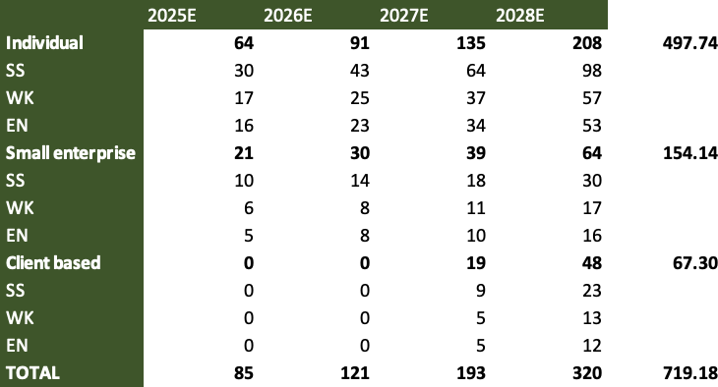
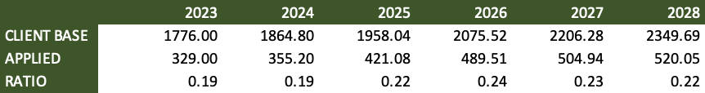
APPENDIX
Financials: Estimation of each loan category takers in each province

Slide 43
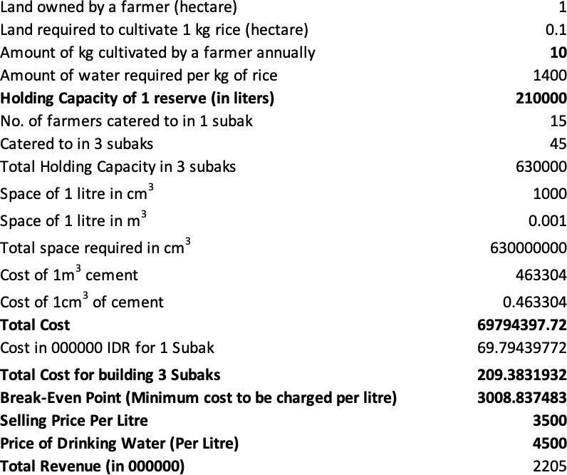
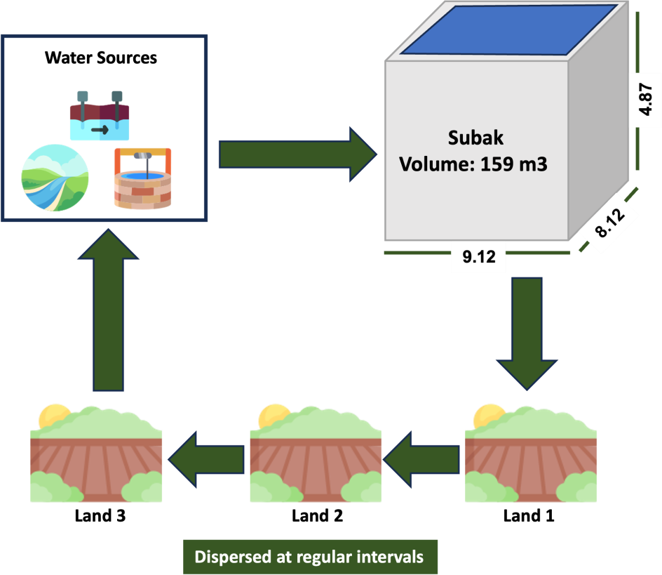
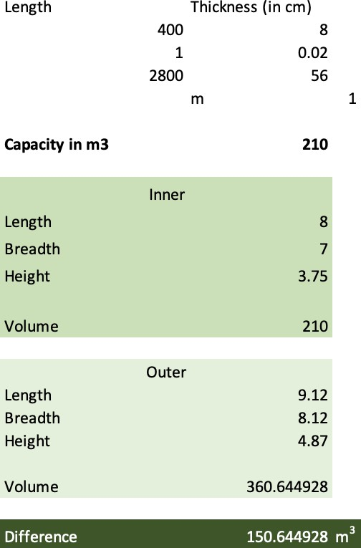
APPENDIX
Financials: Subak's cost and revenue projections
Sources Subak Flowchart Subak Operations

Slide 44
APPENDIX
Sources
https://www.ripublication.com/gjmbs_spl/gjmbsv3n5_12.pdf
https://artoo.com/Accion-Case-Study.pdf
https://content.centerforfinancialinclusion.org/wp-content/uploads/sites/2/2018/08/IIF-CFI_FI-Fintech_Partnerships_Final.pdf
https://bali.com/bali/travel-guide/culture/subak-bali-water-irrigation-system/
https://www.bps.go.id/
https://jurnalsetjen.kemendagri.go.id/index.php/bjgs/article/view/121/33
What Is The Purpose Of Water Towers? | WaterWorld
https://devportalawards.org/nominees/2022/developer-portal-briapi
https://devportalawards.org/nominees/2022/developer-portal-briapi
https://finca.org/our-work/microfinance#:~:text=Microfinance%20refers%20to%20the%20financial,sometimes%20called%20microloans%20or%20microcredit.
https://preferredbynature.org/projects/empowering-indonesian-rice-farmers-sustainable-practices-better-livelihoods
https://amartha.com/en/business/embedded-lending-en/
https://www.researchgate.net/publication/329915393_KOMIDA_Implementing_Digital_Microfinance_in_Indonesia
https://pages.stern.nyu.edu/~adamodar/New_Home_Page/datafile/ctryprem.html
https://pages.stern.nyu.edu/~adamodar/
https://www.huawei.com/minisite/gci/en/country-profile-id.html
https://www.adb.org/publications/improving-indonesia-domestic-connectivity
https://blogs.worldbank.org/eastasiapacific/how-bridge-gap-indonesias-inequality-internet-access
https://www.adb.org/documents/indonesia-vocational-education-strengthening-project-0
https://www.adb.org/results/microfinance-indonesia-bringing-banks-community
https://www.thejakartapost.com/amp/news/2020/11/11/indonesian-internet-users-hit-196-million-still-concentrated-in-java-apjii-survey.html
https://www.hbs.edu/faculty/Pages/item.aspx?num=44533
https://www.researchgate.net/publication/328295616_Indonesian_Microfinance_Institutions_MFI_Move_to_Technology-TBOP's_Prodigy_Experience
https://pages.stern.nyu.edu/~adamodar/New_Home_Page/datafile/Betas.html
https://www.povertyactionlab.org/sites/default/files/review-paper/ifii-whitepaper.pdf
https://www.statista.com/statistics/1251567/indonesia-female-employees-by-sector/#:~:text=As%20of%20August%202022%2C%20around,and%20female%20workers%20in%20Indonesia.
https://assets.kpmg.com/content/dam/kpmg/pdf/2016/07/id-ksa-financial-inclusion-indonesia.pdf
https://www.elibrary.imf.org/view/journals/002/2021/047/article-A006-en.xml?ArticleTabs=fulltext
https://pair.australiaindonesiacentre.org/research/connectivity/overview-south-sulawesis-economy/
https://knoema.com/atlas/Indonesia/South-Sulawesi/GDP
https://knoema.com/atlas/Indonesia/West-Kalimantan/topics/Economics/National-Accounts/Real-GDP-growth-rate
https://knoema.com/atlas/Indonesia/South-Sulawesi
https://www.worlddata.info/asia/indonesia/inflation-rates.php#:~:text=The%20inflation%20rate%20for%20consumer,increase%20was%2081.98%20million%20percent.

Slide 45
APPENDIX
Sources
https://binarapps.com/what-is-branchless-banking-what-are-the-benefits/
https://cn.knoema.com/atlas/%e5%8d%b0%e5%ba%a6%e5%b0%bc%e8%a5%bf%e4%ba%9a/East-Nusa-Tenggara/topics/Demographics/Population/Male-population
https://www.adb.org/sites/default/files/publication/28666/trade-growth-horizons.pdf
https://www.aijcrnet.com/journals/Vol_4_No_12_December_2014/5.pdf
https://www.redalyc.org/journal/947/94768442002/html/
https://www.mdpi.com/2073-445X/7/4/148
https://www.nowbali.co.id/balis-subak-system-irrigation/
https://www.nowbali.co.id/balis-subak-system-irrigation/

